Slide 1



Diabetes Readmission Prediction
Madhukar Ayachit
DSC 680

Slide 2
Executive Summary
Hospital readmission rates for certain conditions like diabetes are now considered an indicator of hospital quality, and also affect the cost of care adversely.
So, we use the medical dataset available on UCI to find best models which can help predict the readmission of diabetic patients.
Used Python and it’s libraries like scikit-learn for machine learning, seaborn and matplotlib for visualization etc.
Using different Logistic Regression
Madhukar Ayachit
DSC 680

Slide 3
Business Problem
The stakeholder of this project will be the hospital officials who can use the results to figure out which patients have higher readmission chances.
This will help save hospital millions of dollars and also, improve the healthcare quality.
With this project, the aim is to find the best model for readmission prediction and the factors which most likely affect the readmission.
Madhukar Ayachit
DSC 680

Slide 4
Process Used
Data Collection
Data Wrangling
EDA & Visualizations
Modeling
Madhukar Ayachit
DSC 680

Slide 5
About Dataset
The data source used was the UCI website, it represents 10 years (1999-2008) of clinical care at 130 US hospitals and integrated delivery networks.
It includes over 50 features representing patient and hospital outcomes. There are around 1,00,000 records.
The data was available in the form of Excel sheet.
It was read in the Python file and the analysis was performed on that data.
Madhukar Ayachit
DSC 680

Slide 6
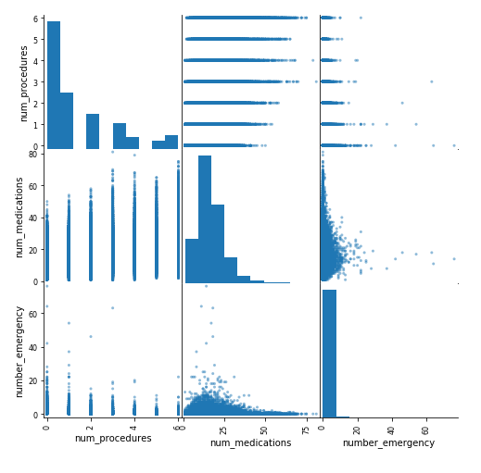
Data Exploration
Madhukar Ayachit
DSC 680

Slide 7
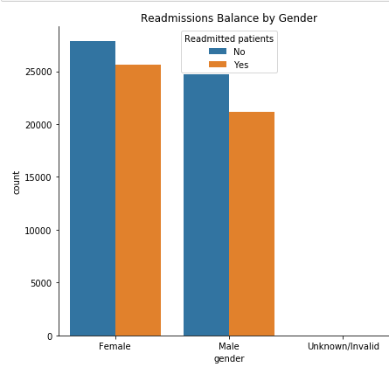
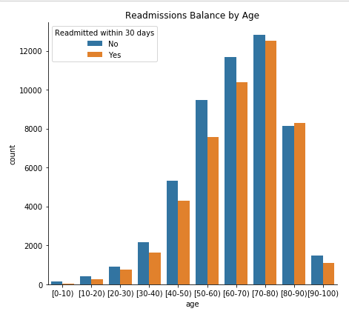
Data Exploration
Madhukar Ayachit
DSC 680

Slide 8
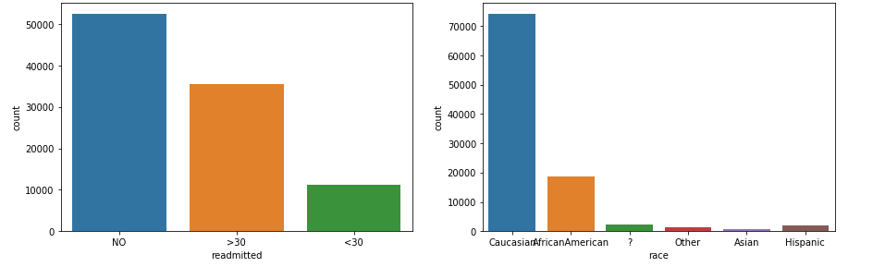
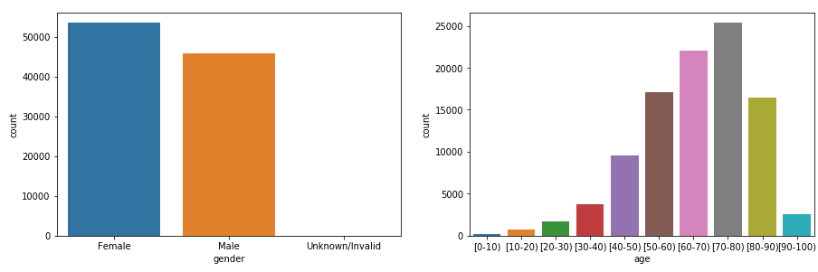
Data Exploration
Madhukar Ayachit
DSC 680

Slide 9
Data Preparation
We had different types of data: numerical, object type and categorical. To apply any model, preprocessing of data is essential.
Dealing with the missing values by dropping the columns which had too many missing values.
Modifying the data like standardization, log transform.
Dealing with the categorical variable like Readmitted to make it dummy variable suitable for applying ML techniques.
The challenge was that there were too many variables so cleaning and making sense of the data was a challenge but step by step approach helps!
Madhukar Ayachit
DSC 680

Slide 10
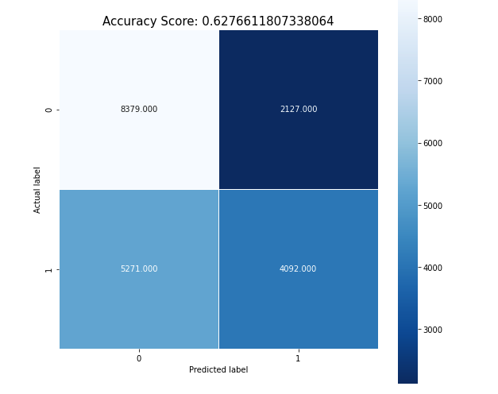
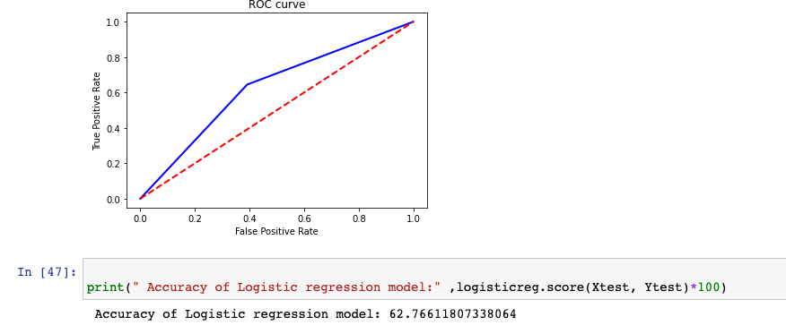
Modeling & Evaluation
Considering binary outcome I have decided to go for logistic regression. Overall result shows 62% accuracy
Madhukar Ayachit
DSC 680

Slide 11
Summary
I am able to successfully run and test model with 62% accuracy. There could be other options like Random Forest, Decision Tree etc but due to binary outcome I have decided to go for Logistic Regression and it gave quiet satisfactory result.
Madhukar Ayachit
DSC 680

